Slide 1

Adverse Allergic
Events in the U.S.
By: Krish Engineer,
Disha Gandhi
Khyati Jariwala,
Varun Kausika,
Nicole Pham-Nguyen
Notes:
Nicole: 1 min
Disha is clicker

Slide 2
AGENDA
01
02
03
BACKGROUND
IMPORTANCE
E.D.A.
04
05
06
MODELS
INSIGHTS
BACK-UP
The background of the
dataset
The importance of the problem
The exploratory analysis done and our intuitions
The models we explored
Solutions and insights based off of our best model
Back-up slides that include graphics, tables, and our dataset
Notes:
Nicole

Slide 3

01
BACKGROUND
A glance at our dataset
Notes:
Nicole

Slide 4

OUR DATASET
COLLECTED:
INCLUDES:
OUR APPROACH:
Adverse allergic events from 2004-2017 by the FDA CFSAN
90,000+ reported adverse allergic events from industries such as: food, cosmetics, and vitamins
Identify the most significant predictors of severe reactions using Naive Bayes, Logistic Regression, kNN, and Random Forest
Notes:
Nicole

Slide 5
Question: Can we predict the seriousness of an individual's outcome and its significant predictors?
Notes:
Nicole

Slide 6

02
THE IMPORTANCE
Three reasons why our project is significant
Notes:
Khyati 1 minute- Moving on to the importance of our project

Slide 7
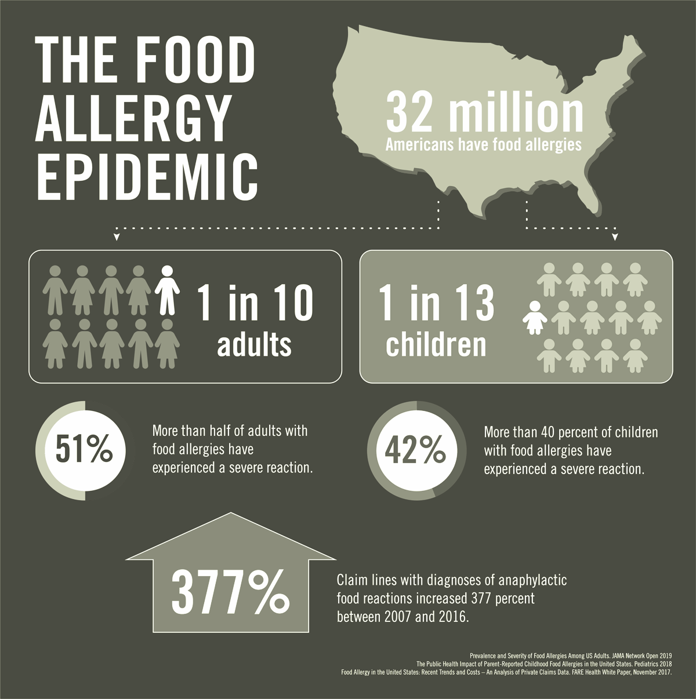
PROJECT IMPORTANCE
Help find a solution to aid the growing allergy problem, particularly the food allergy epidemic
Improve diagnoses through healthcare analytics
Minimize deaths and healthcare costs
Notes:
Khyati - Allergies are a widespread problem that many people face with varying degrees of severity. In particular, the food allergy epidemic is a growing problem that affects about 1 in 10 adults and 1 in 13 children. The ability to predict the seriousness of a person’s allergy allows us to improve diagnoses using healthcare analytics and minimize deaths and healthcare costs. – I’ll hand it over to Varun to talk about EDA

Slide 8

03
EXPLORATORY DATA ANALYSIS
Notes:
Varun: 3-4 minutes

Slide 9
EXAMPLES OF DATA PROCESSING PERFORMED:
Data Cleaning
Reactions per Industry
Converted strings to lists, scaled data, dropped duplicates, removed incomplete rows
Found the most common reactions per industry
Symptoms per Industry
Encoding
Found the most common symptoms experienced per industry
One-Hot encoding for dependent variable: severity of reaction
Full plots available in Back-Up
Notes:
Varun

Slide 10
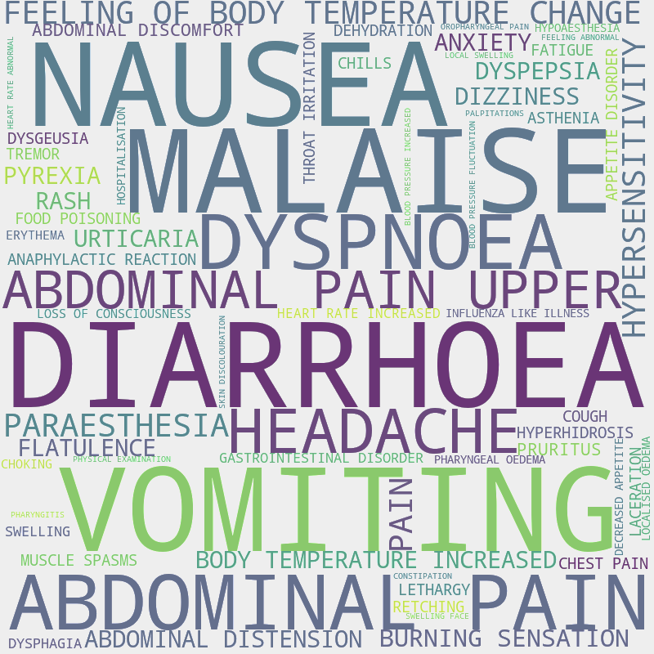
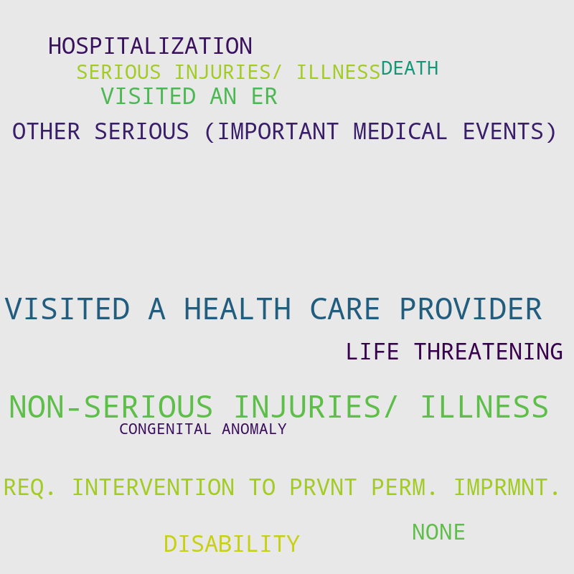
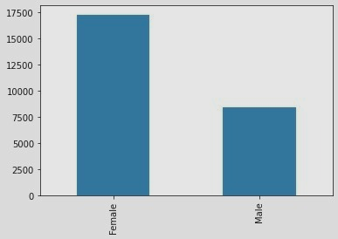
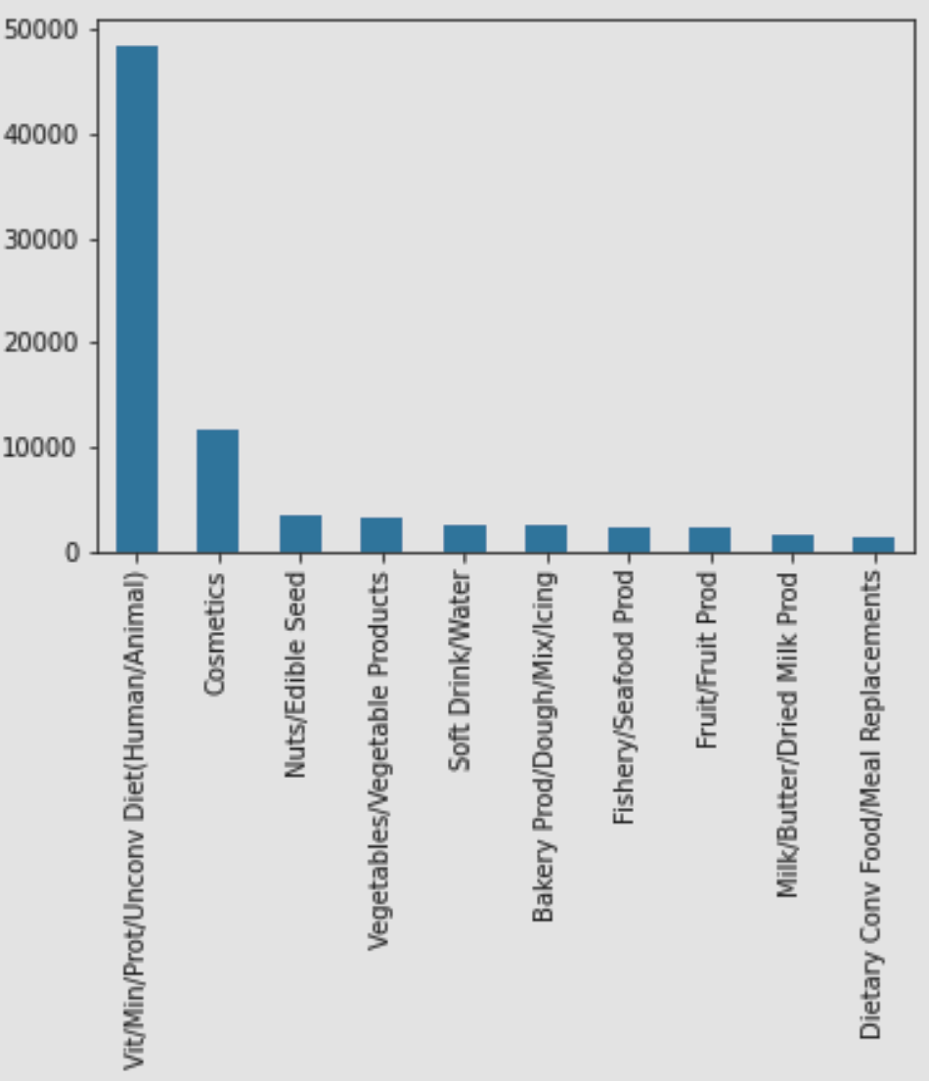
MOST COMMON…
GENDER
INDUSTRY
SYMPTOMS
OUTCOMES
Notes:
Varun

Slide 11
SOME PATTERNS & ABNORMALITIES
SYMPTOMS
GENDER
NON-SERIOUS INJURIES
All industries share the same top 3 symptoms except for the cosmetics industry and the vitamin industry
Women account for 64.66% of reported cases and also dominate the number of serious injuries
All industries, with the exception of vitamins, dietary conventional food/meal replacements, cosmetics, baby food, and coffee/tea mostly contribute to non-serious injuries
Notes:
Varun

Slide 12

04
MODELS
Naive Bayes, Logistic Regression, kNN, Random Forest
Notes:
Disha: 1.5 minutes

Slide 13
MODEL COMPARISON
 | BASELINE ACCURACY | TRAINING ACCURACY | TESTING ACCURACY | RECALL | FEATURES INCLUDED
NAIVE BAYES | 76.62% | 73.42% | 73.05% | 84.0% | Industry
LOGISTIC REGRESSION | 76.62% | 84.2% | 83.9% | 92.0% | Industry
kNN | 76.62% | 82.45% | 81.15% | 96.0% | All
RANDOM FOREST | 76.62% | 87.89% | 84.72% | 95.0% | Industry, Age
Notes:
Disha

Slide 14

05
SOLUTIONS AND INSIGHTS
Notes:
Krish: 2

Slide 15
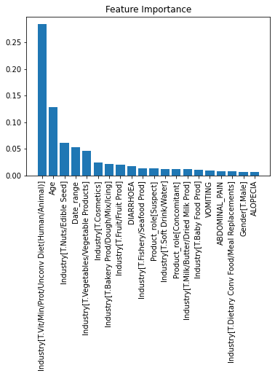
MOST ACCURATE MODEL:
RANDOM FOREST
Had the highest combination of testing and recall scores
Industry and age were biggest predictors
Interesting note: vitamin industry was listed as most important feature but cosmetics was only #6
Notes:
Krish

Slide 16
THANK YOU!
QUESTIONS?
Notes:
Krish

Slide 17
BACK-UP

Slide 18
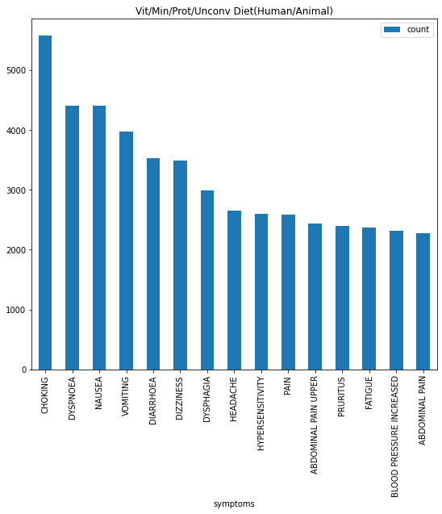
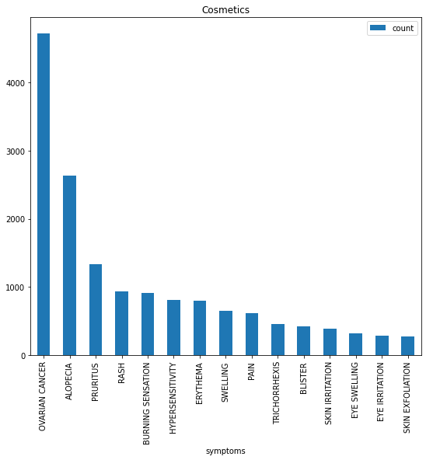
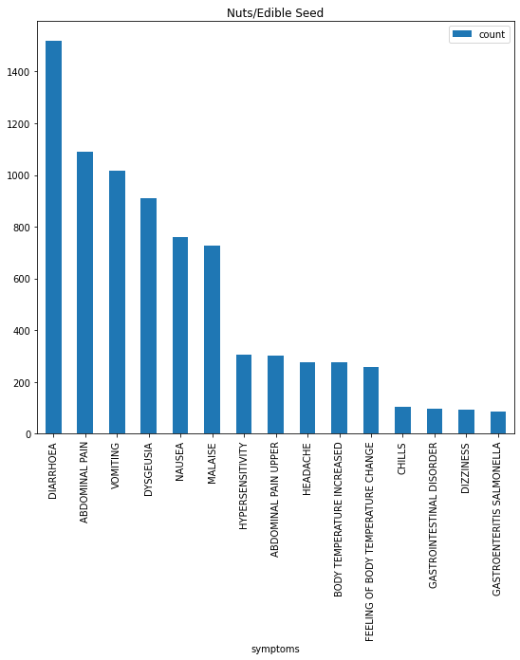
Figure 1. The 15 most common symptoms for the top 15 industries that frequently result in symptoms

Slide 19
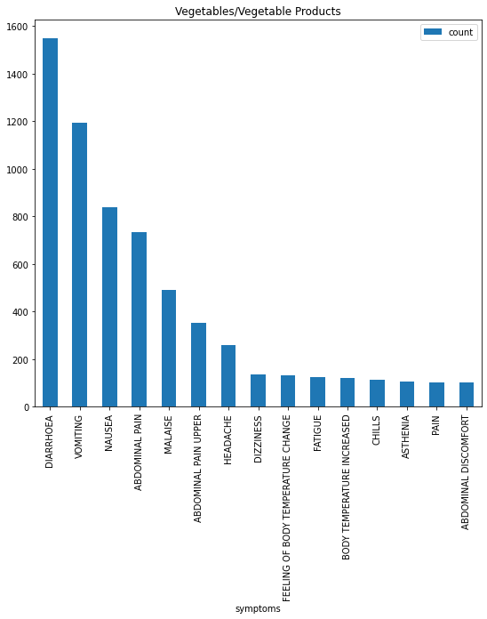
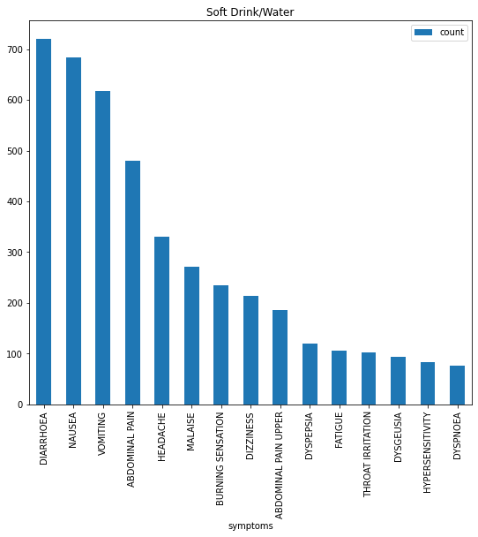
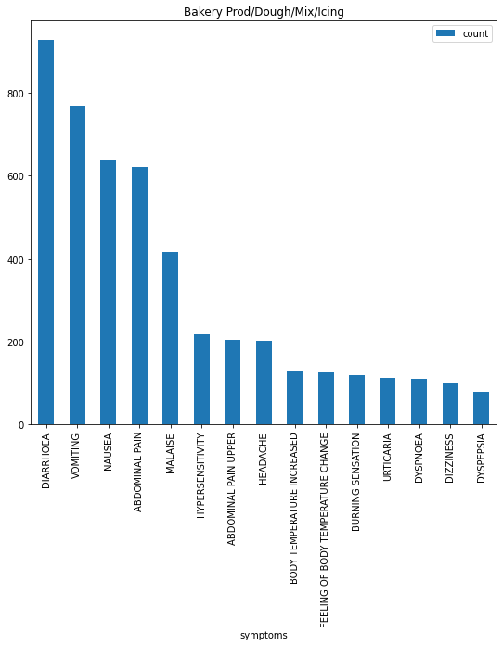
Figure 1. The 15 most common symptoms for the top 15 industries that frequently result in symptoms

Slide 20
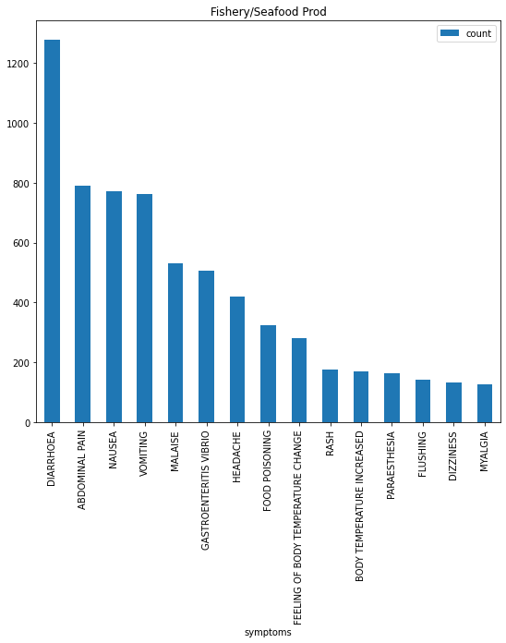
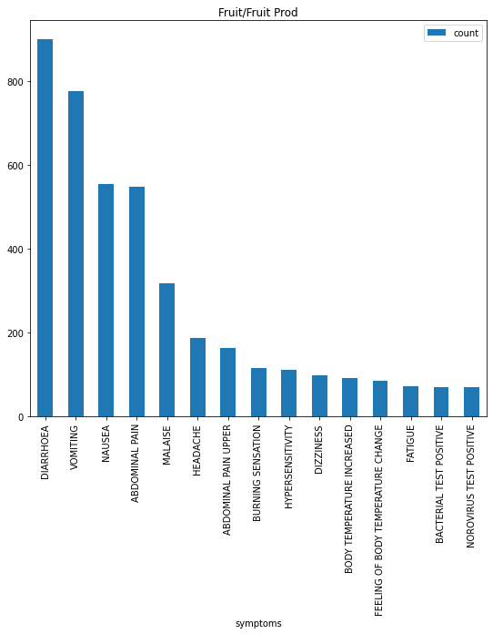
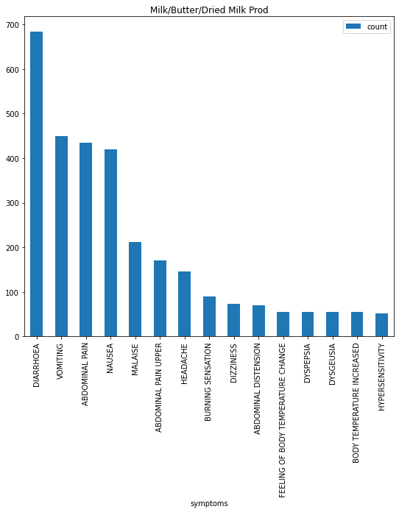
Figure 1. The 15 most common symptoms for the top 15 industries that frequently result in symptoms

Slide 21
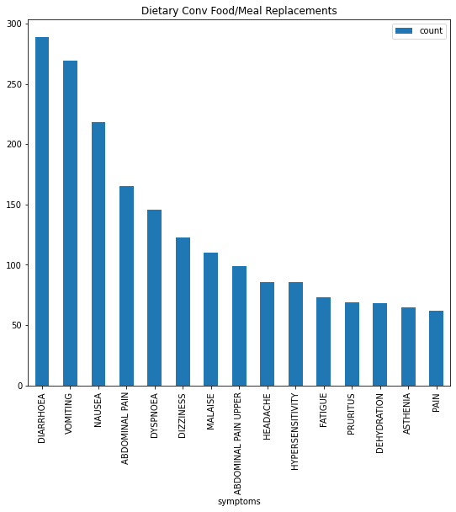
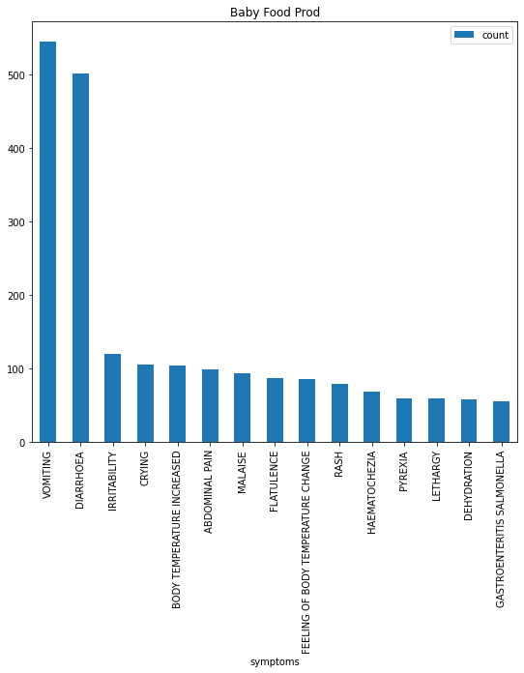
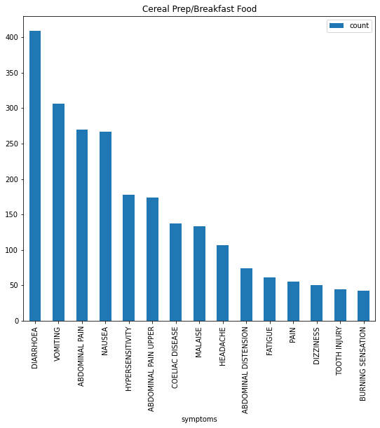
Figure 1. The 15 most common symptoms for the top 15 industries that frequently result in symptoms

Slide 22

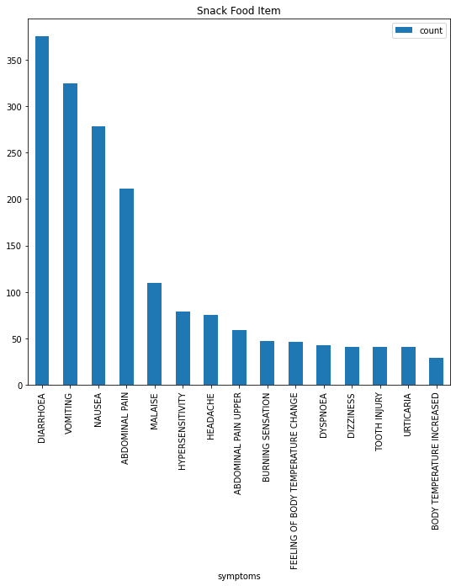
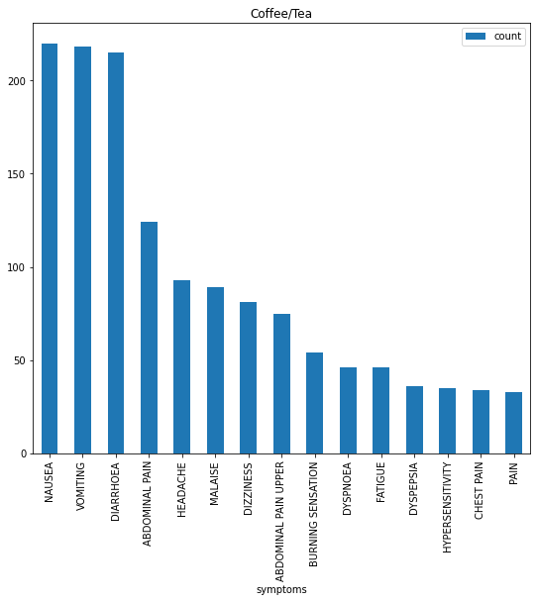
Figure 1. The 15 most common symptoms for the top 15 industries that frequently result in symptoms

Slide 23
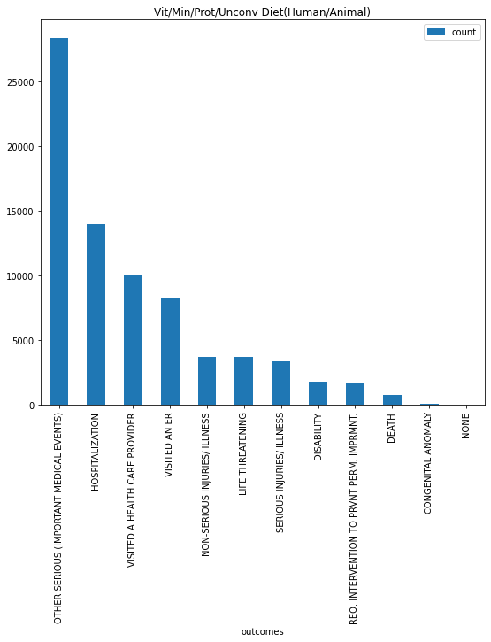
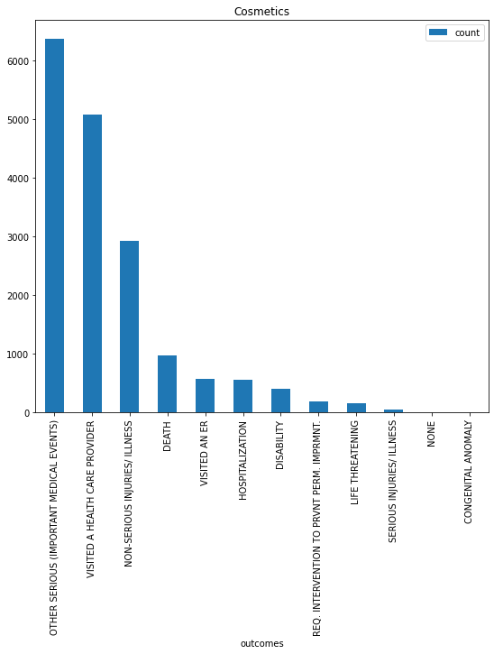
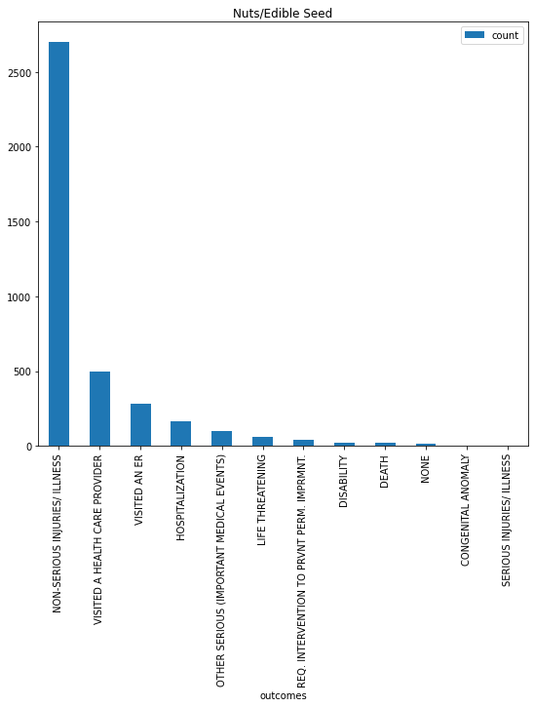
Figure 2. The 15 most common outcomes for the top 15 industries that frequently result in symptoms

Slide 24
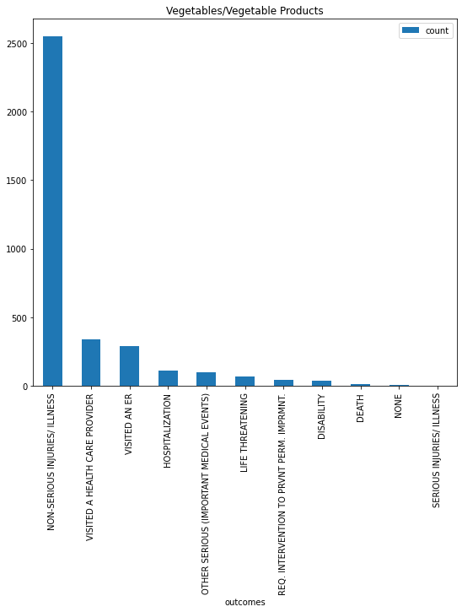
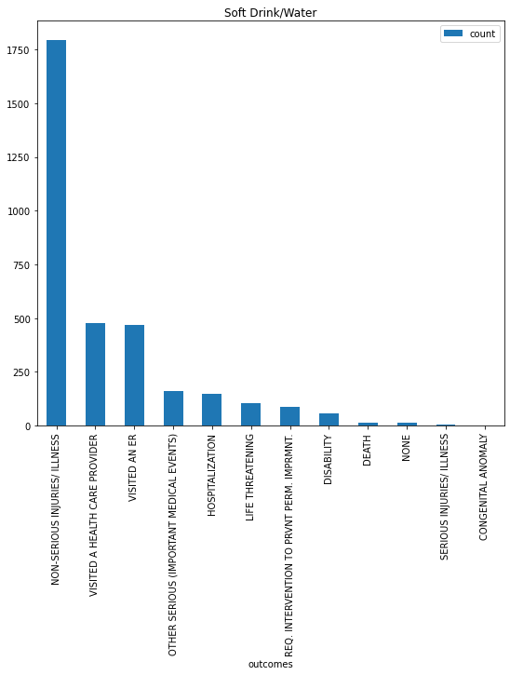
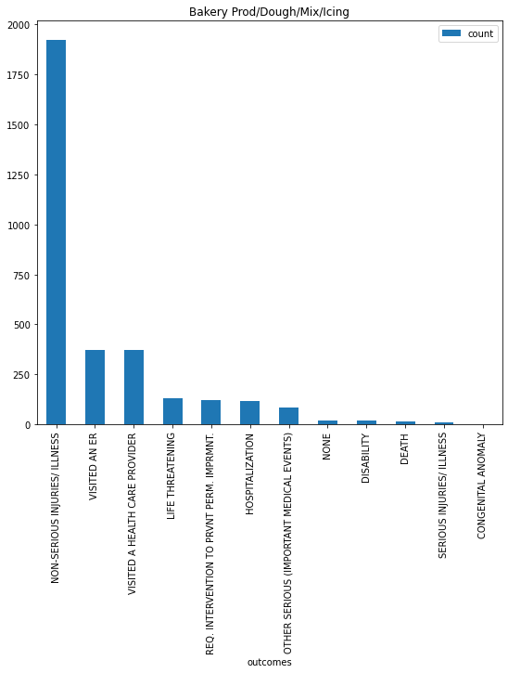
Figure 2. The 15 most common outcomes for the top 15 industries that frequently result in symptoms

Slide 25
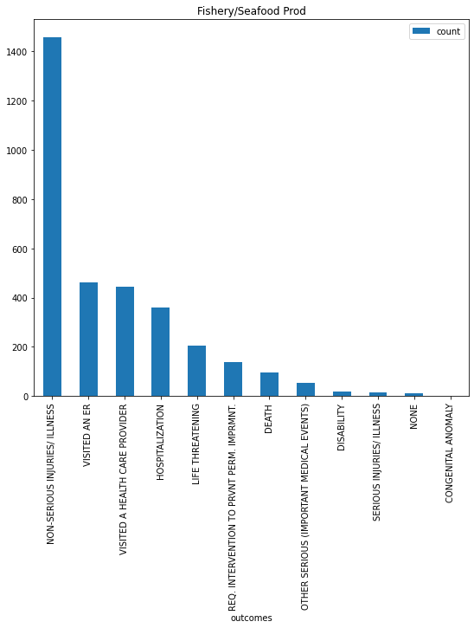
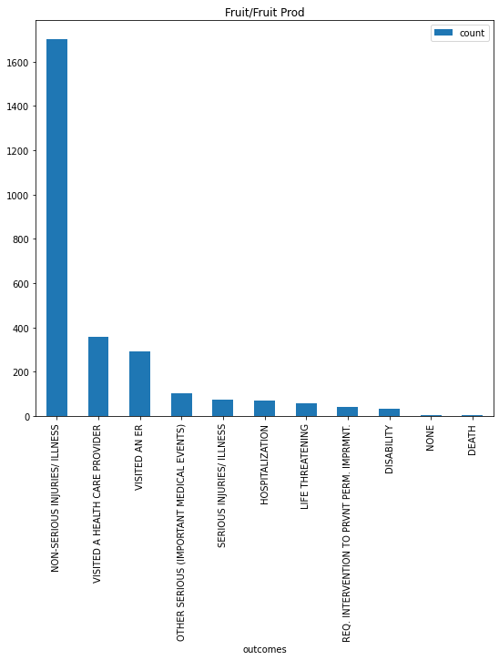
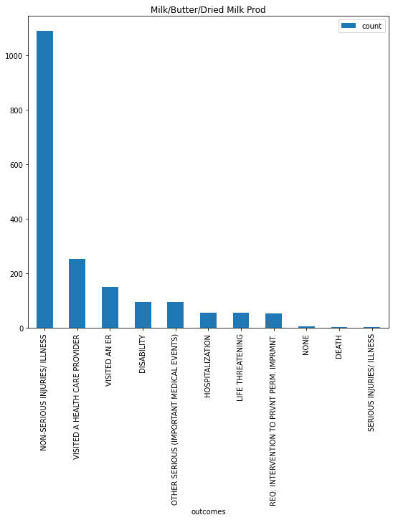
Figure 2. The 15 most common outcomes for the top 15 industries that frequently result in symptoms

Slide 26
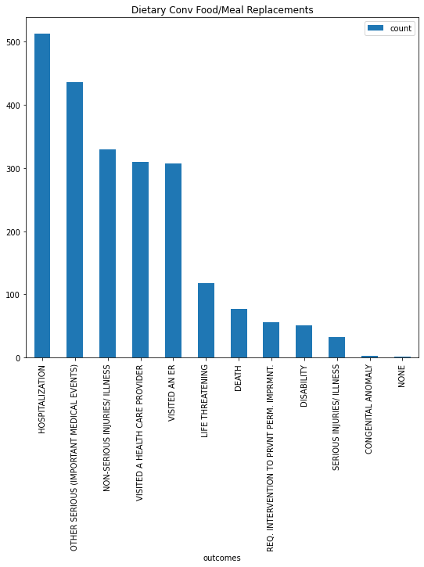
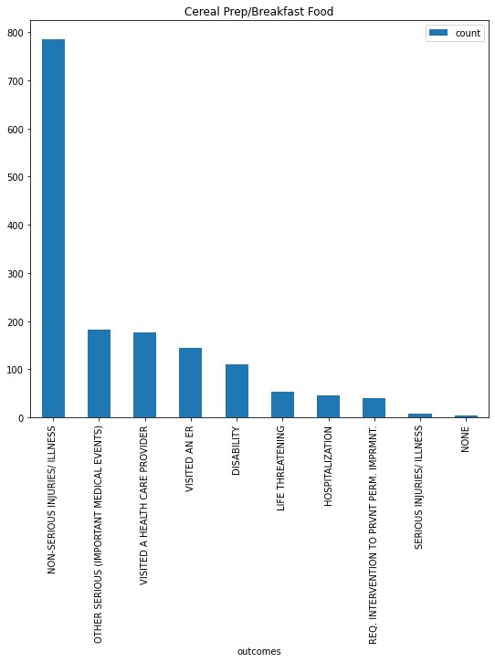
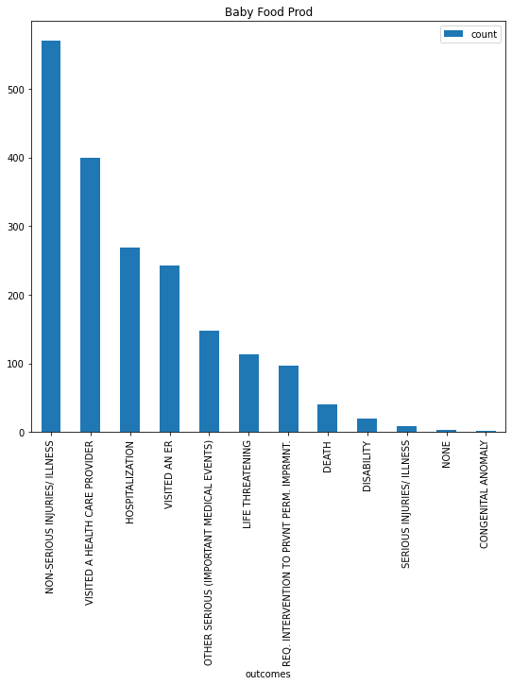
Figure 2. The 15 most common outcomes for the top 15 industries that frequently result in symptoms

Slide 27
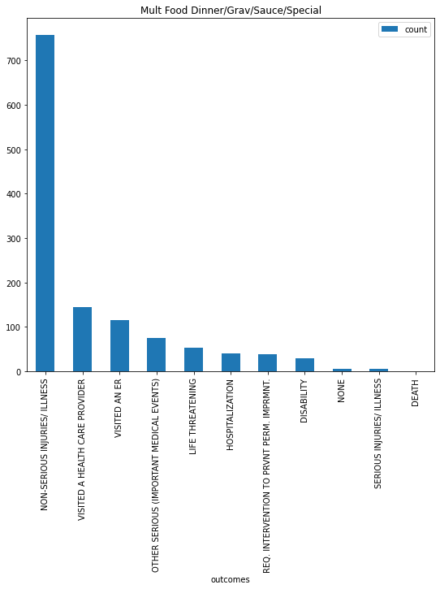

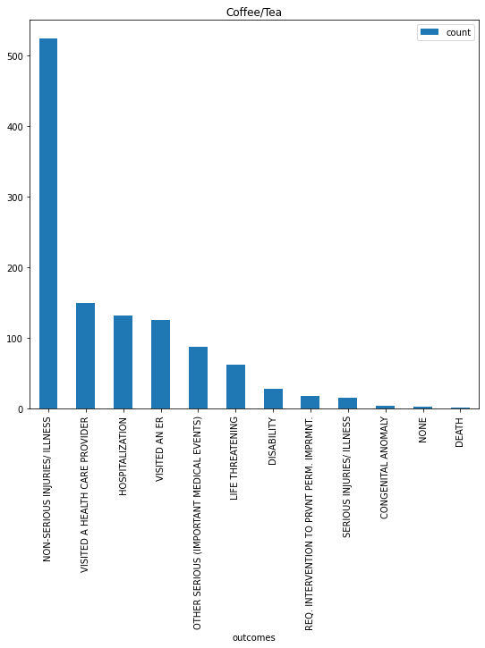
Figure 2. The 15 most common outcomes for the top 15 industries that frequently result in symptoms

Slide 28
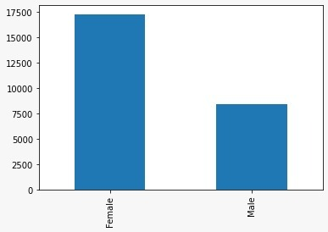
Figure 3. Number of Reported Female and Male Allergic Reactions

Slide 29
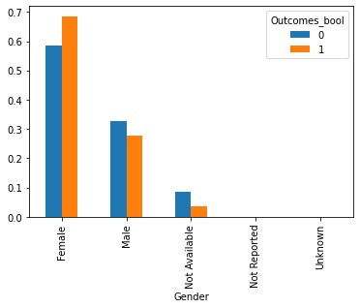
Figure 4. Comparison of the fraction of serious to non-serious cases grouped by gender prior to data cleaning

Slide 30
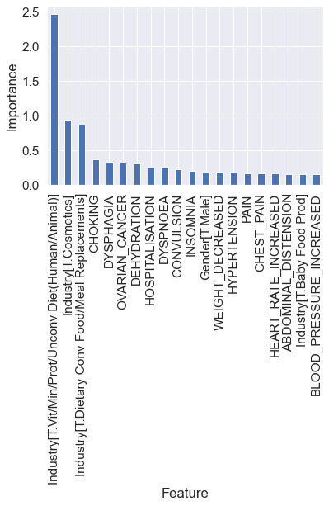
Figure 5. Feature importance bar plot from logistic regression model

Slide 31
Figure 6. Feature importance bar plot from random forest model

Slide 32
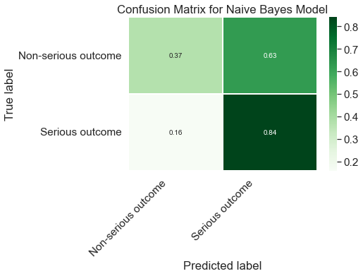
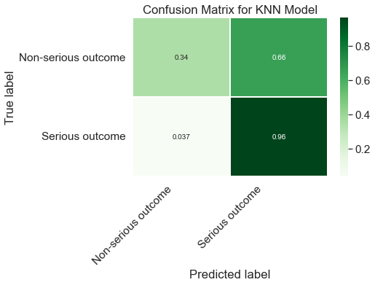
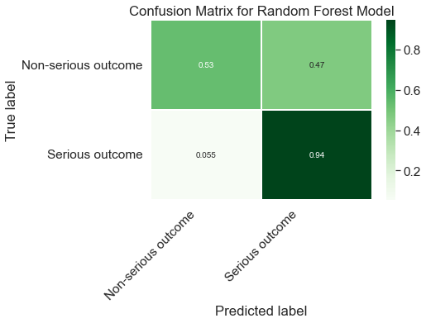
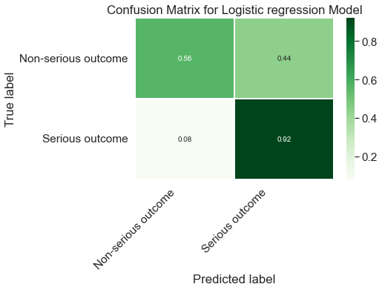
Figure 7-10. Confusion matrices for all models; contains the breakdown of true positives, true negatives, false positives, and false negatives

Slide 33
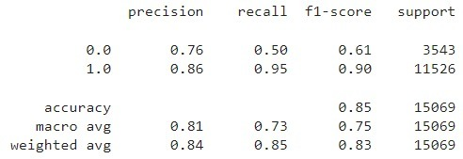
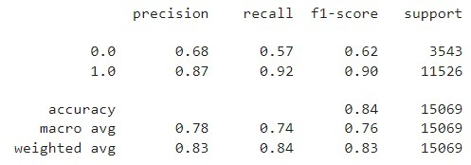
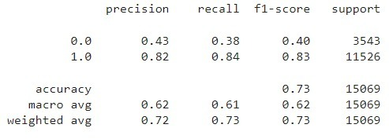
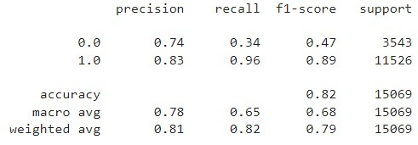
Figure 11-15. Calculated precision, recall, f1-score, and support for Random Forest, Logistic Regression, Naive Bayes, kNN
Random Forest
Logistic Regression
Naive Bayes
kNN

Slide 34
Table 1. Top 3 symptoms in each of the top 15 industries with frequently occurring symptoms
Industry | Top 3 Symptoms
Vit/Min/Prot/Unconv Diet (Human/Animal) | Choking, Dyspnoea, Nausea
Cosmetics | Ovarian Cancer, Alopecia, Pruritus
Nuts/Edible Seed | Diarrhoea, Abdominal Pain, Vomiting
Vegetables/Vegetable Products | Diarrhoea, Vomiting, Nausea
Soft Drink/Water | Diarrhoea, Nausea, Vomiting
Bakery Prod/Dough/Mix/Icing | Diarrhoea, Vomiting, Nausea
Fishery/Seafood Prod | Diarrhoea, Abdominal Pain, Nausea
Fruit/Fruit Prod | Diarrhoea, Vomiting, Nausea
Milk/Butter/Dried Milk Prod | Diarrhoea, Vomiting, Abdominal Pain
Dietary Conv Food/Meal Replacements | Diarrhoea, Vomiting, Nausea
Baby Food Prod | Vomiting, Diarrhoea, Irritability
Cereal Prep/Breakfast Food | Diarrhoea, Vomiting, Abdominal Pain
Mult Food Dinner/Grav/Sauce/Special | Diarrhoea, Vomiting, Nausea
Snack Food Item | Diarrhoea, Vomiting, Nausea
Coffee/Tea | Nausea, Vomiting, Diarrhoea

Slide 35
Table 2: Classification of outcomes as serious or non-serious
Non-Serious Outcomes | Serious Outcomes
VISITED AN ER | REQ. INTERVENTION TO PRVNT PERM. IMPRMNT
VISITED A HEALTH CARE PROVIDER | HOSPITALIZATION
NON-SERIOUS INJURIES/ILLNESS | DEATH
NONE | LIFE THREATENING
 | DISABILITY
 | SERIOUS INJURIES/ ILLNESS
 | CONGENITAL ANOMALY
 | OTHER SERIOUS (IMPORTANT MEDICAL EVENTS)

Slide 36
Table 3: Top 3 outcomes in each of the top 15 industries with frequently occurring symptoms; red coloring indicates serious events as defined by Table 2
Industry | Top 3 Outcomes
Vit/Min/Prot/Unconv Diet (Human/Animal) | Other Serious (Medical Events), Hospitalization, Visited a Provider
Cosmetics | Other Serious (Medical Events), Visited a Provider, Non-Serious Injuries/Illness
Nuts/Edible Seed | Non-Serious Injuries/Illness, Visited a Provider, Visited an ER
Vegetables/Vegetable Products | Non-Serious Injuries/Illness, Visited a Provider, Visited an ER
Soft Drink/Water | Non-Serious Injuries/Illness, Visited a Provider, Visited an ER
Bakery Prod/Dough/Mix/Icing | Non-Serious Injuries/Illness, Visited an ER, Visited a Provider
Fishery/Seafood Prod | Non-Serious Injuries/Illness, Visited an ER, Visited a Provider
Fruit/Fruit Prod | Non-Serious Injuries/Illness, Visited a Provider, Visited an ER
Milk/Butter/Dried Milk Prod | Non-Serious Injuries/Illness, Visited a Provider, Visited an ER
Dietary Conv Food/Meal Replacements | Hospitalization, Other Serious (Medical Events), Non-Serious Injuries/Illness
Baby Food Prod | Non-Serious Injuries/Illness, Visited a Provider, Hospitalization
Cereal Prep/Breakfast Food | Non-Serious Injuries/Illness, Other Serious (Medical Events), Visited a Provider
Mult Food Dinner/Grav/Sauce/Special | Non-Serious Injuries/Illness, Visited a Provider, Visited an ER
Snack Food Item | Non-Serious Injuries/Illness, Visited a Provider, Visited an ER
Coffee/Tea | Non-Serious Injuries/Illness, Visited a Provider, Hospitalization

Slide 37
Picture/Infographic Credits
https://www.dreamstime.com/allergy-food-concept-allergies-to-fish-eggs-citrus-fruits-ch-chocolate-mushrooms-nuts-health-medicine-white-background-top-image128775747
https://stock.adobe.com/search?k=%22food+background%22&asset_id=443370711
https://www.nm.org/healthbeat/healthy-tips/are-you-allergic-to-your-makeup
https://www.atlantaallergy.com/articles/view/319-the-food-allergy-epidemic
https://www.midwestallergyrelief.com/natural-remedies-for-grass-and-ragweed-allergies/
https://unsplash.com/s/photos/tea-cafe
https://unsplash.com/s/photos/solution

Slide 38

THANK YOU!
addyouremail@freepik.com
+91 620 421 838
yourcompany.com
Please keep this slide for attribution
CREDITS: This presentation template was created by Slidesgo, including icons by Flaticon and infographics & images by Freepik

